Slide 1


EMPLOYEE DATA ANALYSIS
Presented By: Shambhavi S

Slide 2
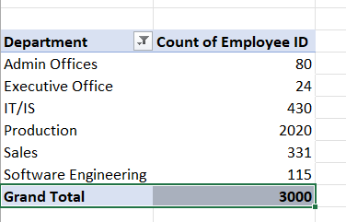
Can you create a pivot table to summarize the total number of employees in each department?
Executive office has the least number of employees
Production Department has the highest number of employees

Slide 3
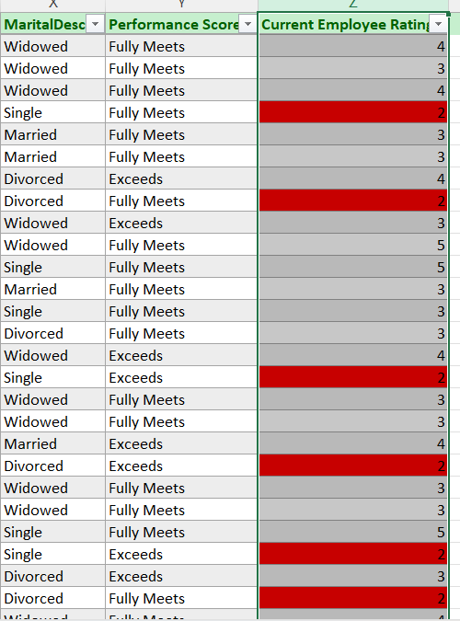
Apply conditional formatting to highlight employees with a "Performance Score" below 3 in red.

Slide 4
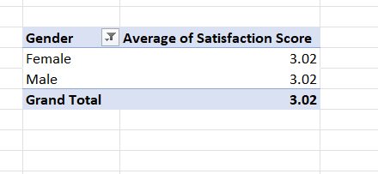
Calculate the average "Satisfaction Score" for male and female employees separately using a pivot table.

Slide 5
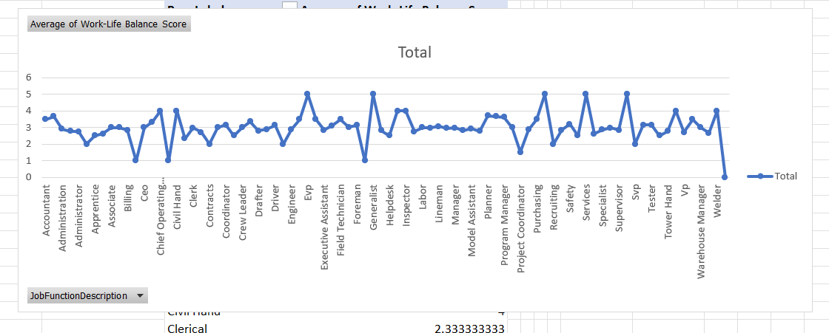
Create a chart to visualize the distribution of "Work-Life Balance Score" for different job functions.

Slide 6
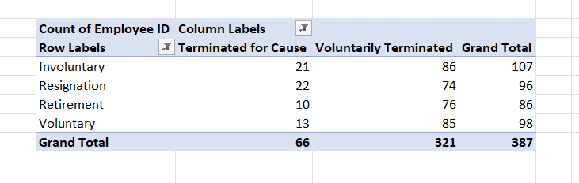
Filter the data to display only terminated employees and find out the most common "Termination Type."
Involuntary has 107 terminations which is the highest.

Slide 7
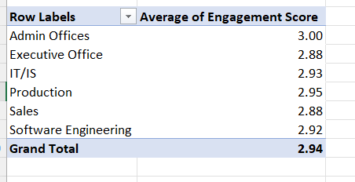
Calculate the average "Engagement Score" for each department using a pivot table.
Admin Office has the Highest Average engagement scores i.e. 3

Slide 8
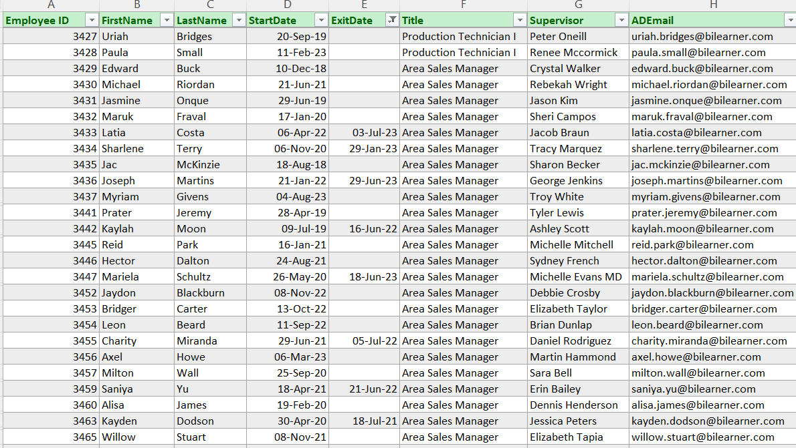

Use VLOOKUP to find the supervisor's email address for a specific employee.

Slide 9
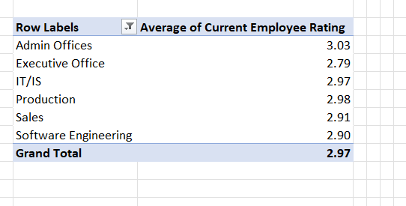
Can you identify the department with the highest average "Employee Rating?"
Admin Office has the highest Average Employee Rating 3.03

Slide 10
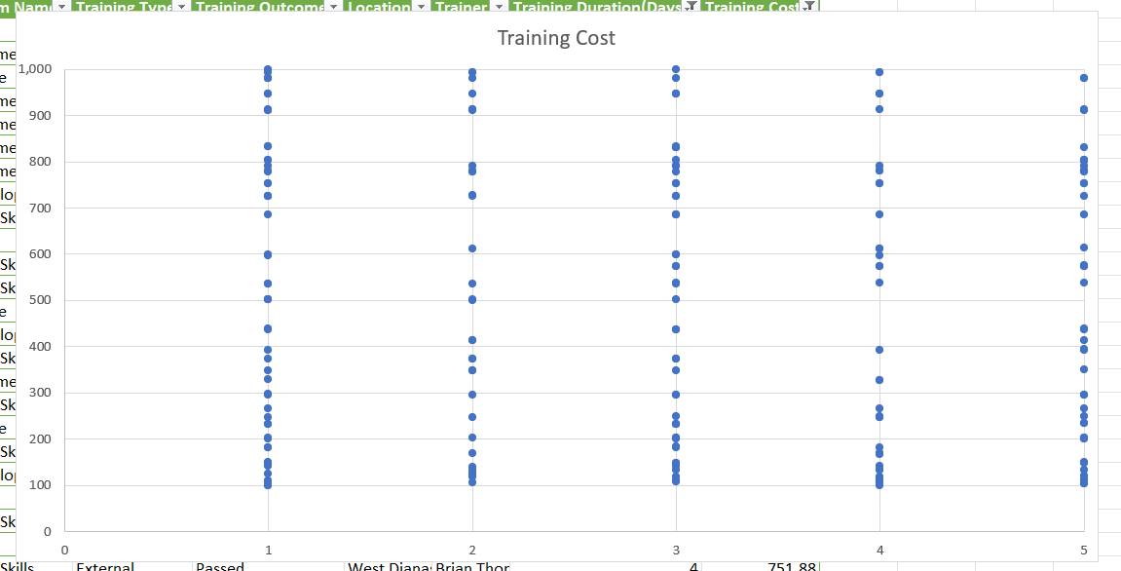
Create a scatter plot to explore the relationship between "Training Duration (Days)" and "Training Cost."

Slide 11
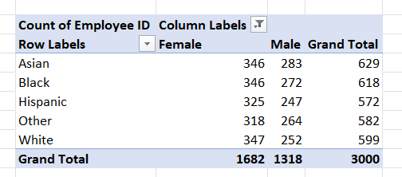
Build a pivot table that shows the count of employees by "RaceDesc" and "GenderCode."

Slide 12
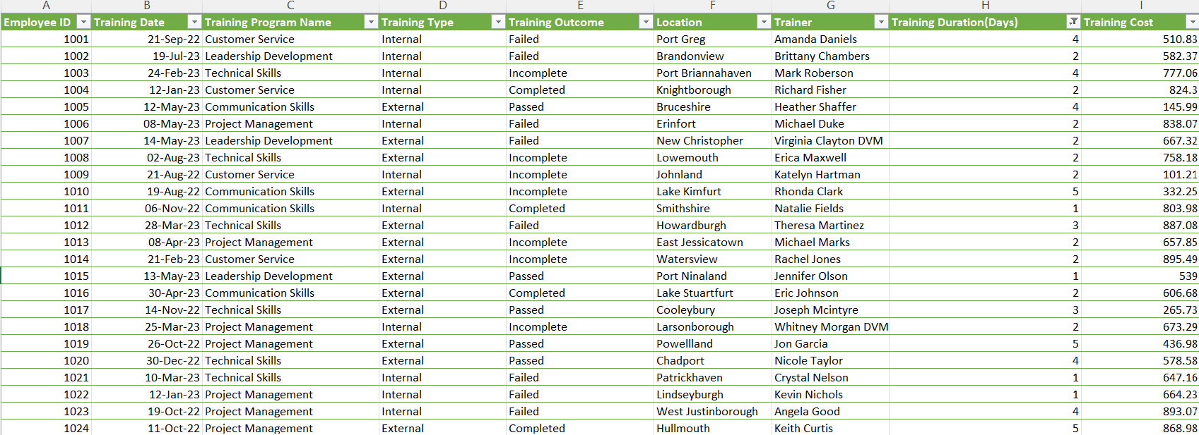

Use INDEX and MATCH functions to find the "Training Program Name" for an employee with a specific ID.

Slide 13
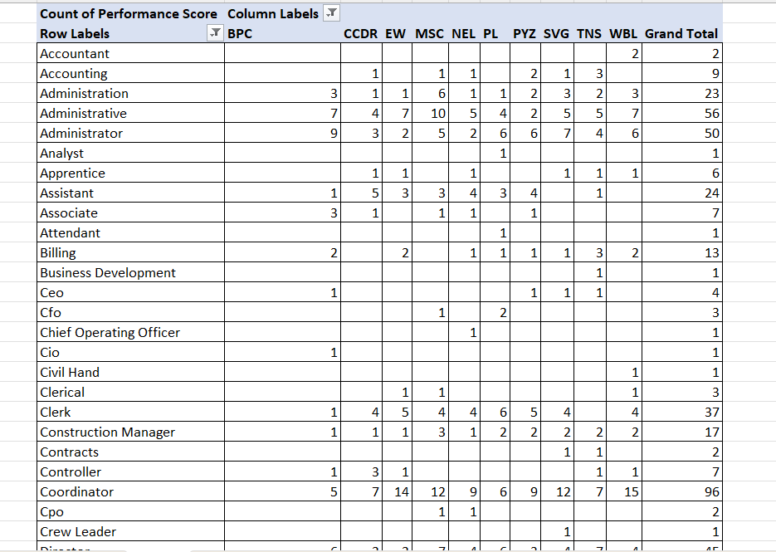
Create a multi-level pivot table to analyze the "Performance Score" by "BusinessUnit" and "JobFunctionDescription."

Slide 14
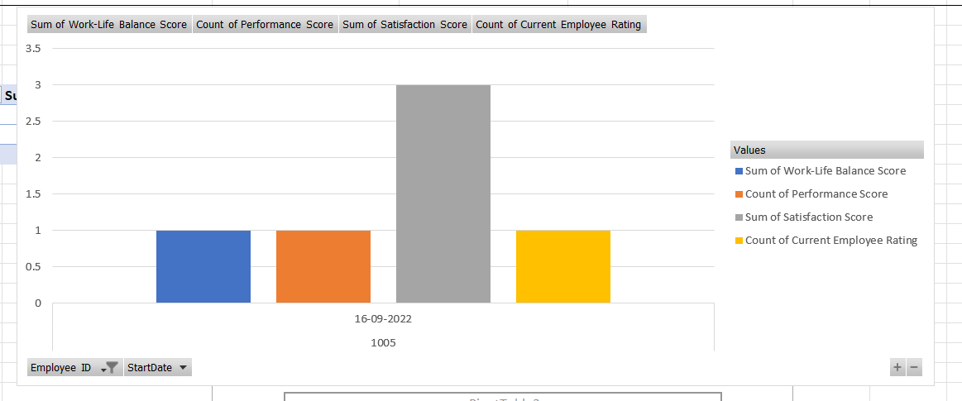
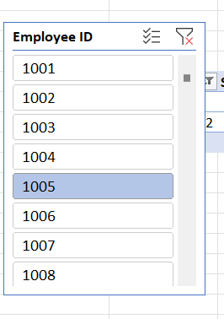
Design a dynamic chart that allows users to select and visualize the performance of any employee over time.

Slide 15
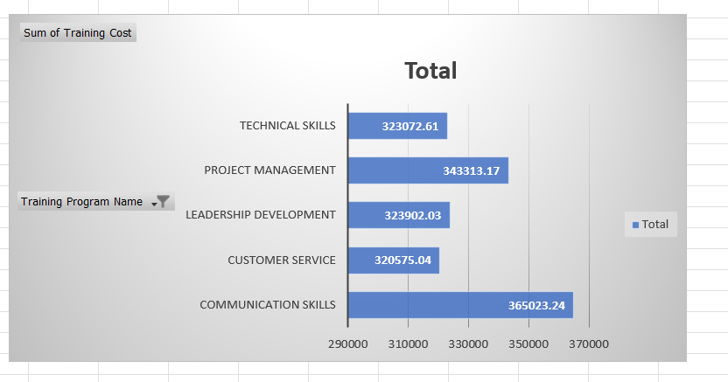
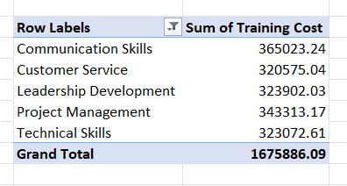
Calculate the total training cost for each "Training Program Name" and display it in a bar chart.

Slide 16
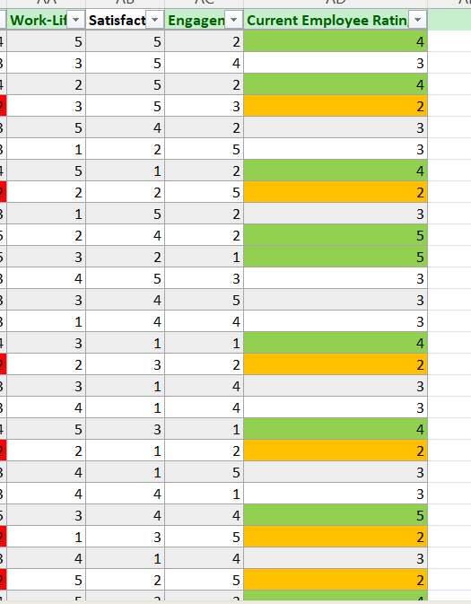
Apply advanced conditional formatting to highlight the top 10% and bottom 10% of employees based on "Current Employee Rating."
Top 10% in Green
Bottom 10% in Yellow

Slide 17
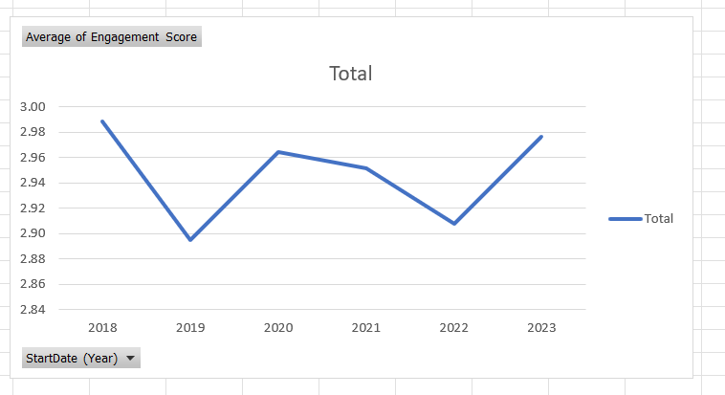
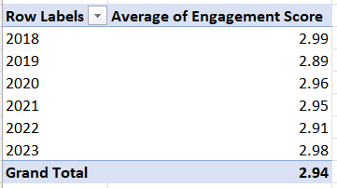
Use a calculated field in a pivot table to determine the average "Engagement Score" per year.

Slide 18
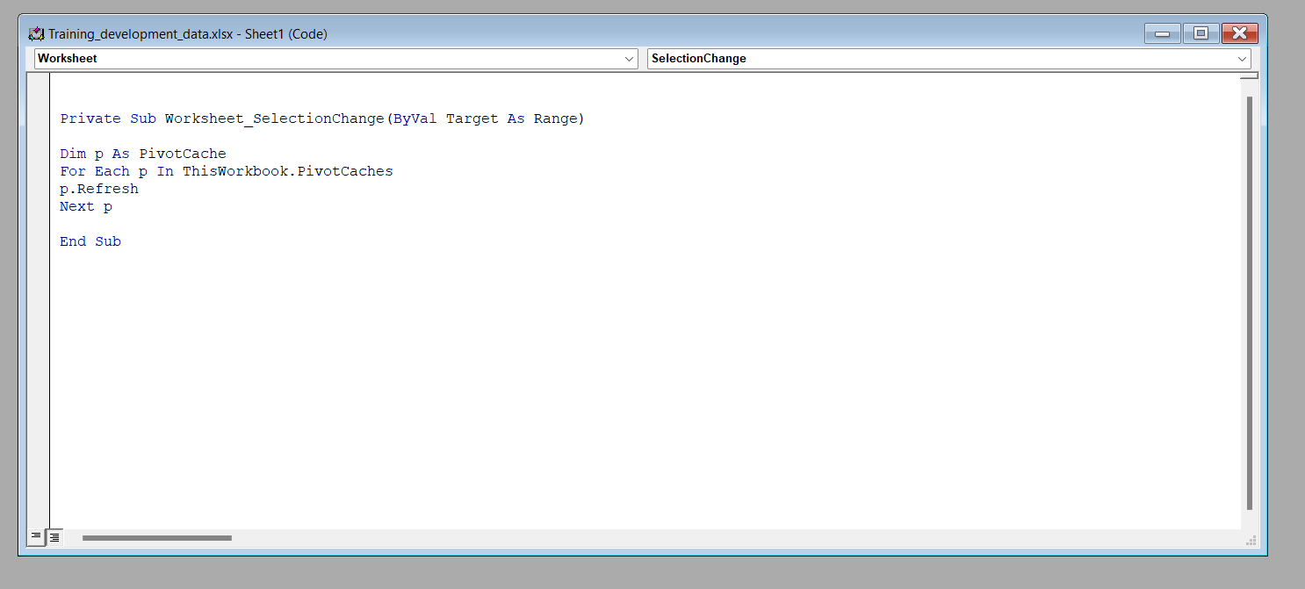
Can you build a macro that automates the process of updating and refreshing all pivot tables in the workbook?

Slide 19
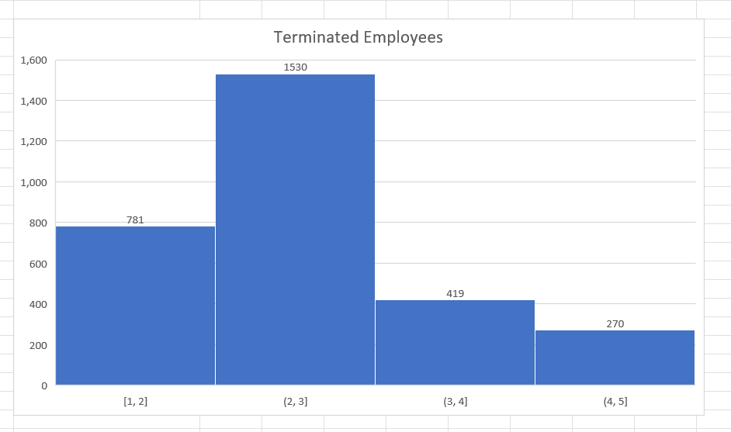
Create a histogram to understand the distribution of "ExitDate" for terminated employees.

Slide 20
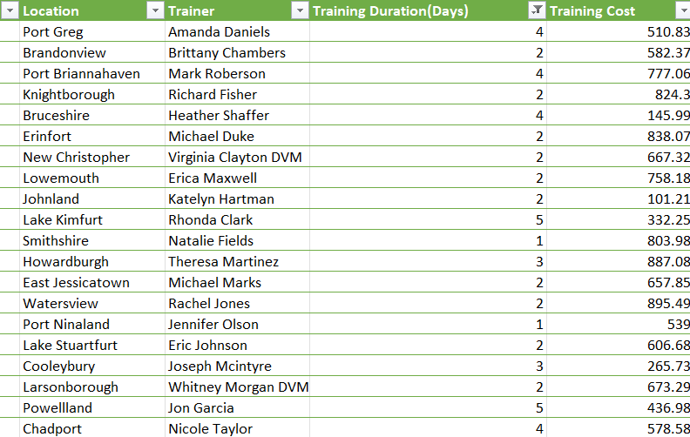


Utilize the SUMPRODUCT function to calculate the total training cost for employees in a specific location.

Slide 21
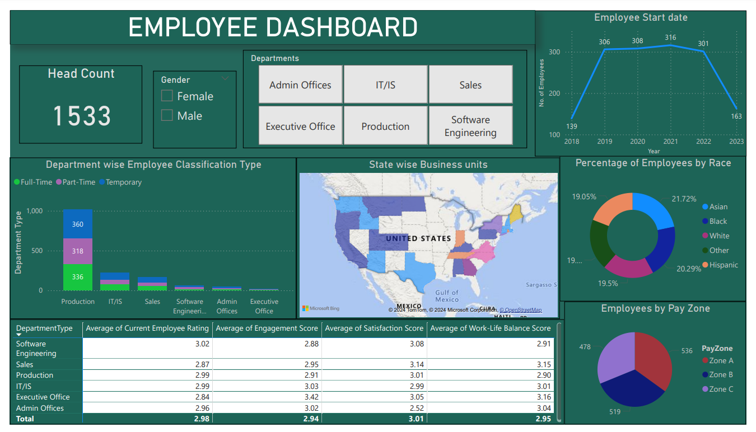

Slide 22
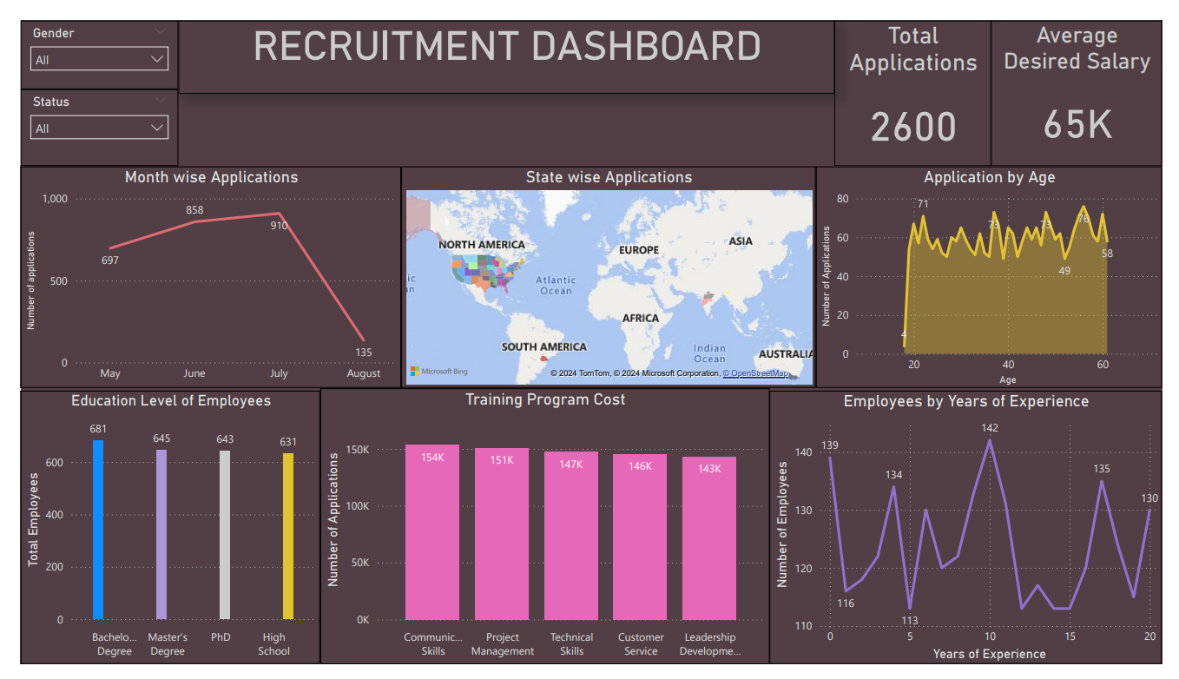

Slide 23

THANK YOU

